Slide 1
Computer organization and architecture
Shriram K Vasudevan

Slide 2
Control signals
Shriram K Vasudevan
Session - 13

Slide 3
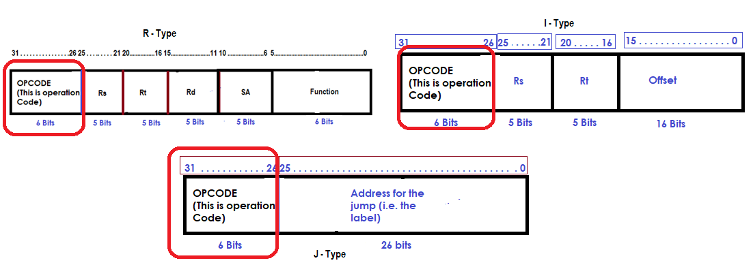
Recollect this
OPCODE is part of the 32 bits and it is positioned between the bits 26 – 31 (0 – 31). R Type / I Type / J Type all have the same position for the OP.

Slide 4
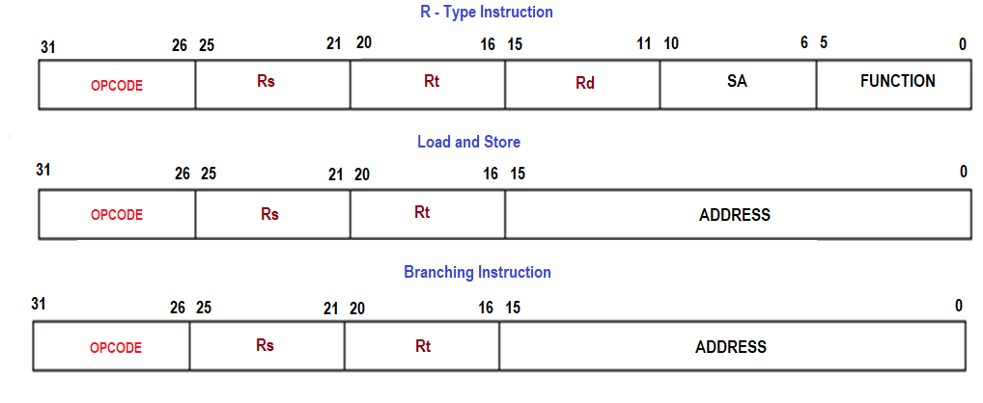
Contd.,
When it comes to register representation it is always Rs, Rt being the source registers for all R Type instructions, BEQ or Store instructions. The positions of Rs and Rt never changes and can be seen from the format. (refer previous slide).
Rs is always consistent in its position for LW and SW.

Slide 5
Contd.,
Having looked into these identities, we could come to a decision of using multiplexors at appropriate places.
Wherever multiplexors are used in this datapath, it will have only 2 inputs.
Also, there is definite need for control signal and one control signal shall be there for each multiplexor we use in the data path.
Also, we could decide on the usage of the control signals for the datapath to work fine.
Recollect the control signals we used sometime back.

Slide 6
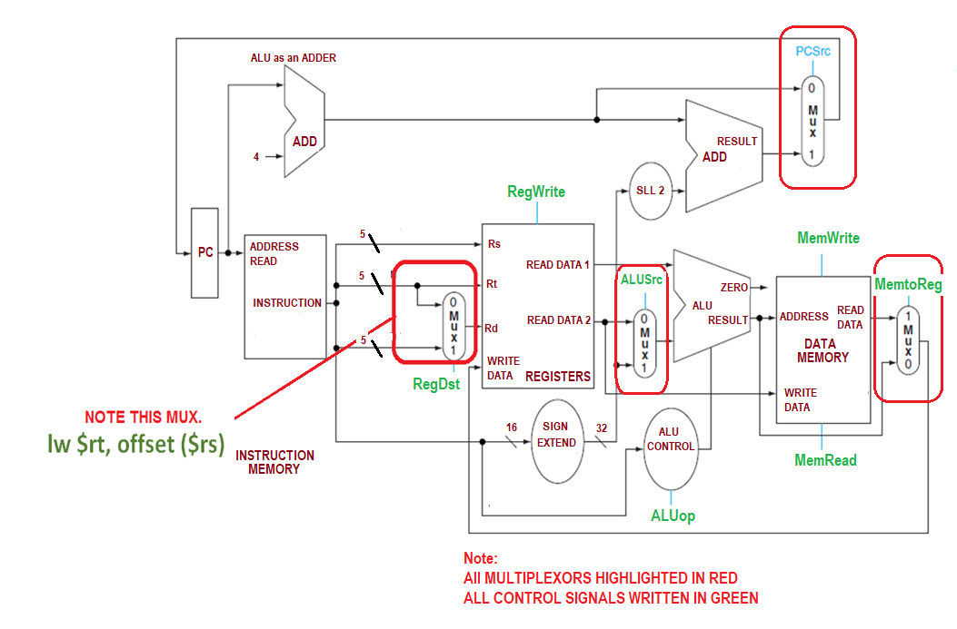
Contd.,
Note:
Assert – to represent a signal as logically high.
De-assert – logically low.
Note this points:
1. The figure is complete now with all the multiplexors included.
2. All the control signals are in place.
3. ALU Control is also added to make the datapath complete.
Also, there is no PCWrite as MemWrite or RegWrite. (This happens automatically at the end of each clock cycle and no one needs to give an alarm to do this task)

Slide 7
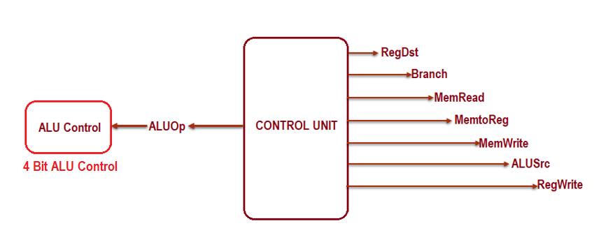
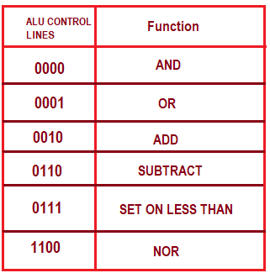
Contd.,
Now comes the real control unit and the control signals in picture.

Slide 8
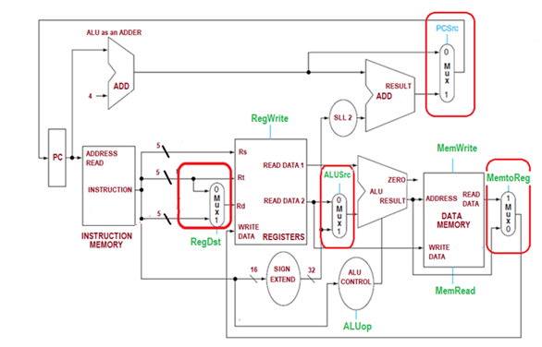
Let us understand the control signals
Control Signal | De-asserted state | Asserted state
RegDst | As one can see from RHS, when de-asserted, destination register is identified by Rt. | If asserted, destination register is identified by Rd.
RegWrite | Not Applicable. | Selected register shall be written with the write data input.
ALUSrc | Input shall be from READ DATA 2 when de-asserted. | Sign extended 32 bit input.
PCSrc | PC shall get value of PC + 4 (This is how the computation happens normally) | This will work for the branching. PC shall be fed with the output of the adder which shall update the branch address.
MemRead | None | Content shall be read from the memory location pointed by the address and made available in Read Data output.
MemWrite | None | Writing into the memory happens from the write data inputs. Memory address generated earlier shall be used.
MemtoReg | Value fed to Register write comes out directly from ALU. | Value fed to Register write comes out directly from data memory.

Slide 9
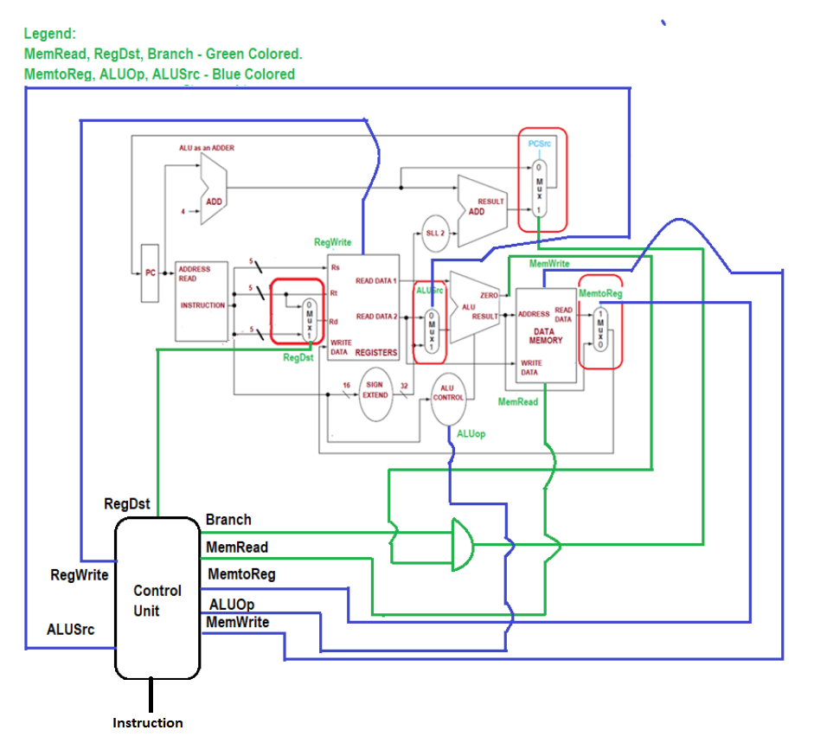
In detail…
Control Signal | De-asserted state | Asserted state
RegDst | As one can see from RHS, when de-asserted, destination register is identified by Rt. | If asserted, destination register is identified by Rd.
RegWrite | Not Applicable. | Selected register shall be written with the write data input.
ALUSrc | Input shall be from READ DATA 2 when de-asserted. | Sign extended 32 bit input.
PCSrc | PC shall get value of PC + 4 (This is how the computation happens normally) | This will work for the branching. PC shall be fed with the output of the adder which shall update the branch address.
MemRead | None | Content shall be read from the memory location pointed by the address and made available in Read Data output.
MemWrite | None | Writing into the memory happens from the write data inputs. Memory address generated earlier shall be used.
MemtoReg | Value fed to Register write comes out directly from ALU. | Value fed to Register write comes out directly from data memory.

Slide 10
Contd.,
The multiplexors are governed by the control signals – RegDst, ALUSrc, MemtoReg.
There are signals which govern the Read and Write. Read and write can be carried out in the Register and Memory. Signals RegWrite, MemRead, MemWrite are taking care of the read and write and control the same.
Branch is the signal which would control the branching.
ALU is controlled by ALUOp.

Slide 11
Contd.,
One could spot and AND gate in the diagram. It is fed with the Branch and Zero output from ALU as input.
This would control what the PC should be. (Means, should it be a branch or should it be a traditional next successive address.
PCSrc does not directly come from the control unit. (Derived signal)

Slide 12
Control signals – for all signals
Shriram K Vasudevan
Session - 14

Slide 13
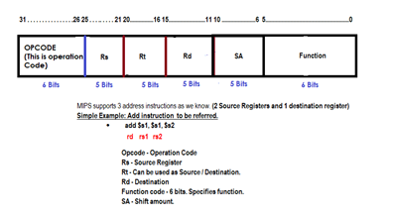
Let us decode the status of the control signals
Control Signal Status for R – Format Instructions:
Let us understand the format once again, with having an instance which we discussed earlier.
Now, it is to be understood what the signals are which could be high/low for R operations to be performed.

Slide 14
FOR R TYPE INSTRUCTIONS
RegDst | ALUSrc | Memto Reg | Reg Write | Mem Read | Mem Write | Branch | ALUOP1 | ALUOP2
1 | 0 | 0 | 1 | 0 | 0 | 0 | 1 | 0
The status of the control signals shall be as shown
above in the table!

Slide 15
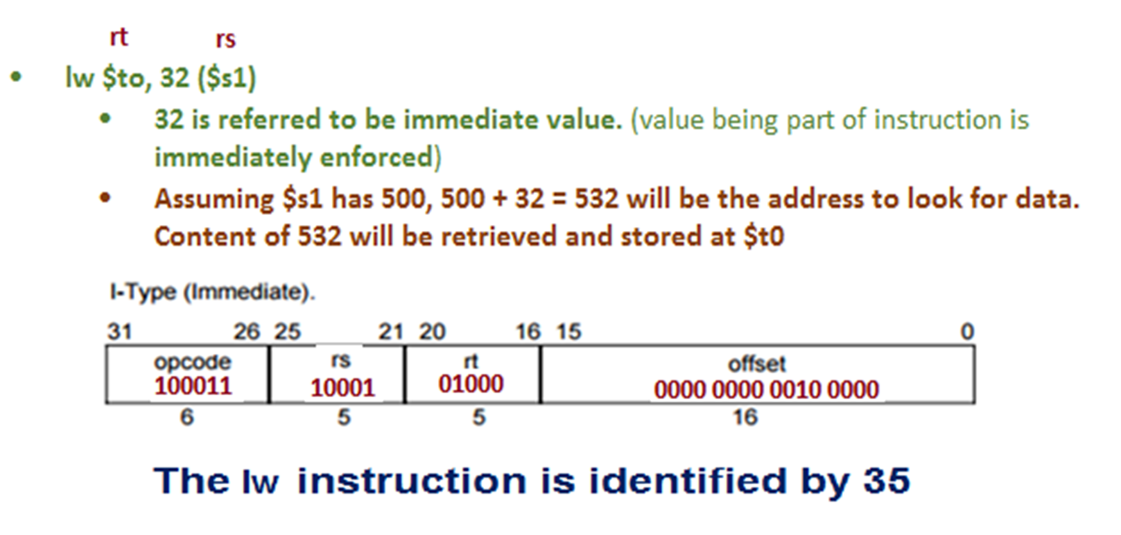
FOR LW INSTRUCTIONS
RegDst | ALUSrc | Memto Reg | Reg Write | Mem Read | Mem Write | Branch | ALUOP1 | ALUOP2
0 | 1 | 1 | 1 | 1 | 0 | 0 | 0 | 0
The status of the control signals shall be as shown
above in the table!
An instance shall help you understanding this better.

Slide 16
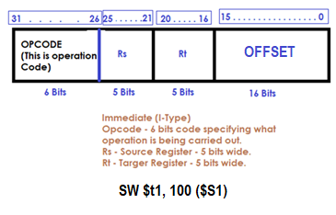
FOR SW INSTRUCTIONS
RegDst | ALUSrc | Memto Reg | Reg Write | Mem Read | Mem Write | Branch | ALUOP1 | ALUOP2
X | 1 | X | 0 | 0 | 1 | 0 | 0 | 0
The status of the control signals shall be as shown
above in the table!
An instance shall help you understanding this better.

Slide 17
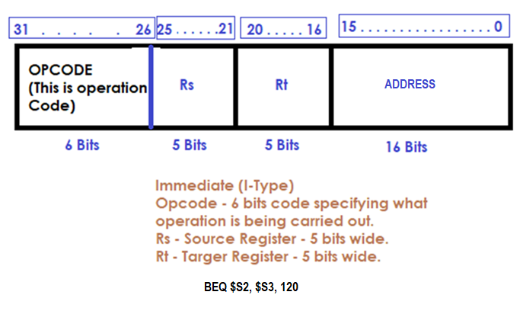
FOR BEQ INSTRUCTIONS
RegDst | ALUSrc | Memto Reg | Reg Write | Mem Read | Mem Write | Branch | ALUOP1 | ALUOP2
X | 0 | X | 0 | 0 | 0 | 1 | 0 | 1
The status of the control signals shall be as shown
above in the table!
An instance shall help you understanding this better.

Slide 18
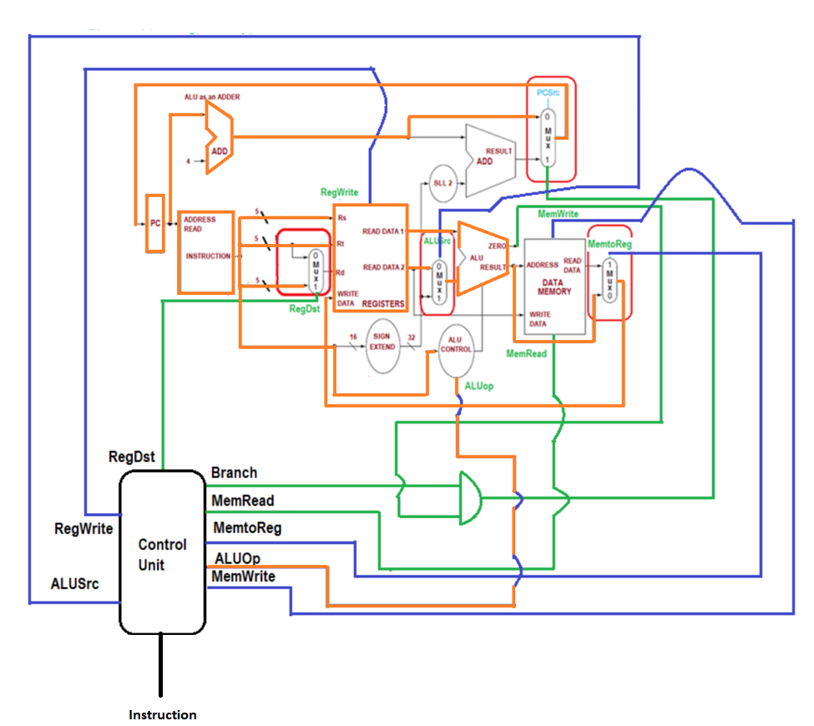
Operation elaboration – R TYPE (We prefer R type here)
How did we trace the path? (Orange line).
1. When the instruction, add $s1, $s2, $s3 is fetched, the PC gets updated (PC + 4). (This is not a branching instruction, hence branching action would not happen).
2.The source registers (Rs, Rt) are read and shall be fed into the ALU.
3. ALU computes the result and writes the result back to the Register Rd. The entire path is highlighted and traced.

Slide 19
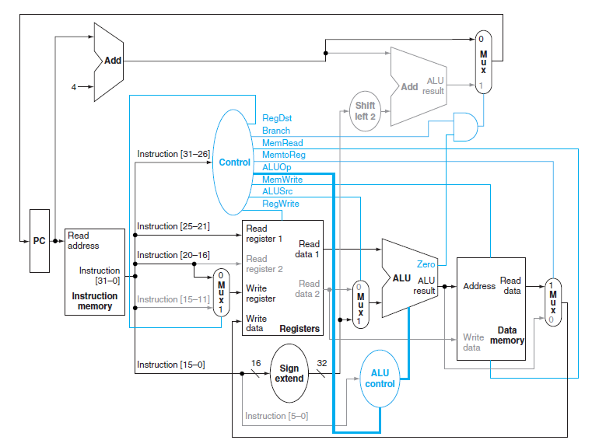
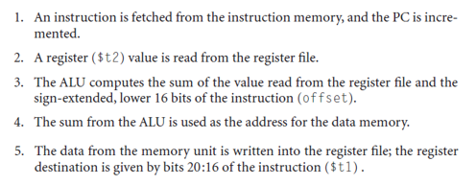
Trace LOAD/STore
The control lines, datapath units, and connections that are active are highlighted.
A store instruction would operate very similarly.
The main difference would be that the memory control would indicate a write rather than a read, the second register value read would be used for the data to store, and the operation of writing the data memory value to the register file would not occur.

Slide 20
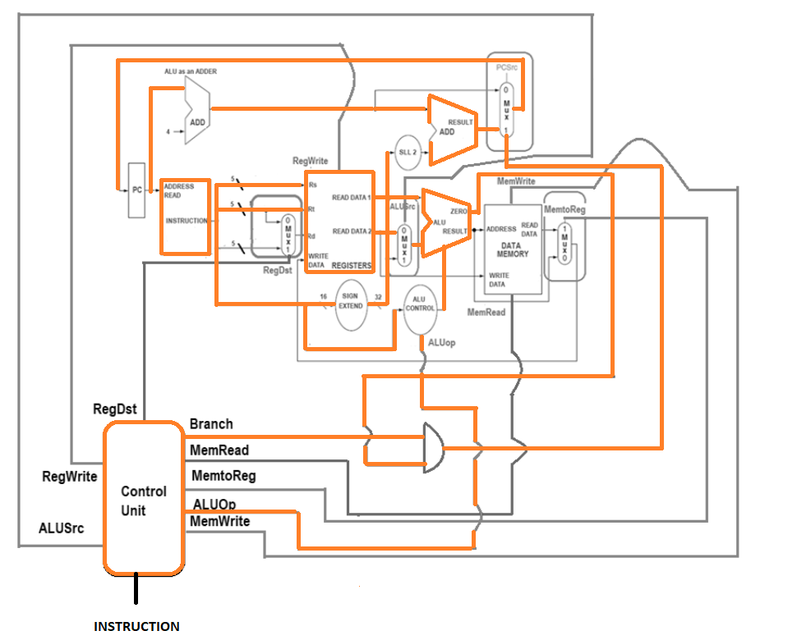
Trace the path for BEQ (Easier)
Instruction is fetched from the memory. 2 registers are to be compared and we know it already.
$s1 and $2 are read and they are compared (Literally subtract happens).
If zero (here we assume it is zero), PC will be updated with appropriate adder result to be stored into the PC. (See the term, Adder result) . The address shall be computed properly by adding PC+4 with sign extended 16 to 32 bit offset.
If not zero, the regular traditional PC + 4 shall be used.
Note: After using the register file and ALU to perform the compare, the Zero output is used to select the next program counter from between the two candidates.

Slide 21
JUMP – a tough zone to play
Shriram K Vasudevan
Session – 15

Slide 22
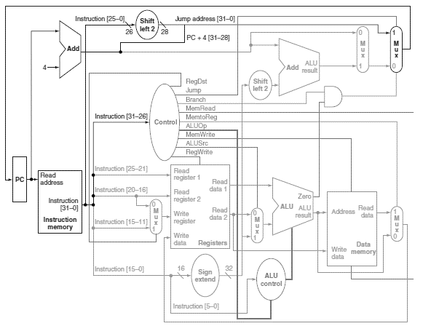
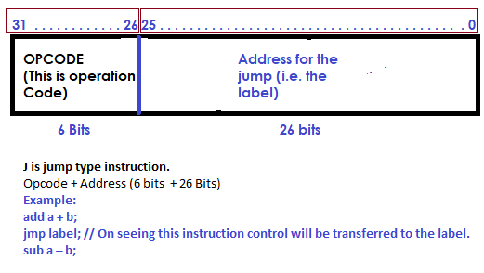
Implementing Jumps!!!! A tough zone!
An additional multiplexor (at the upper right) is used to choose between the jump target and either the branch target or the sequential instruction following this one.
This multiplexor is controlled by the jump control signal.
The jump target address is obtained by shifting the lower 26 bits of the jump instruction left 2 bits, effectively adding 00 as the low-order bits, and then concatenating the upper 4 bits of PC + 4 as the high-order bits, thus yielding a 32-bit address.

Slide 23
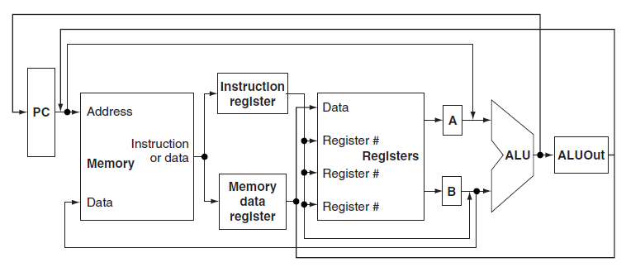
Multicycle Implementation
Multicycle implementation - Also called multiple clock cycle implementation.
An implementation in which an instruction is executed in multiple clock cycles. (Against the one which we considered earlier.. I.e. Single cycle.)
In a multicycle implementation, each step in the execution will take 1 clock cycle.
The multicycle implementation allows a functional unit to be used more than once per instruction, as long as it is used on different clock cycles.
The ability to allow instructions to take different numbers of clock cycles and the ability to share functional units within the execution of a single instruction are the major advantages of a multicycle design.
This picture shows the key elements of the datapath: a shared memory unit, a single ALU shared among instructions, and the connections among these shared units.
The use of shared functional units requires the addition or widening of multiplexors as well as new temporary registers that hold data between clock cycles of the same instruction.
The additional registers are the Instruction register (IR), the Memory data register (MDR), A, B, and ALUOut.

Slide 24
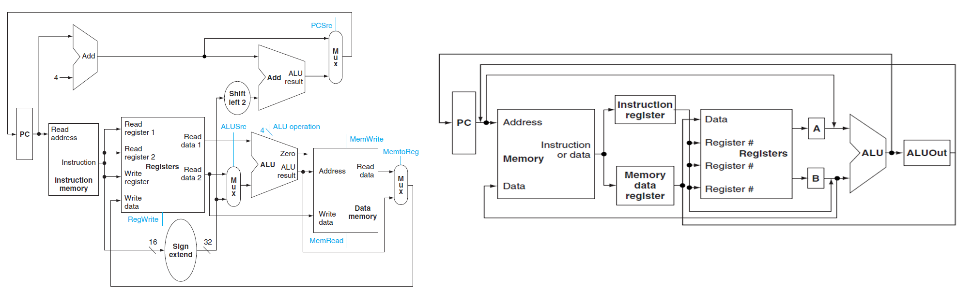
Let us compare…
A single memory unit is used for both instructions and data.
There is a single ALU, rather than an ALU and two adders.
One or more registers are added after every major functional unit to hold the output of that unit until the value is used in a subsequent clock cycle.

Slide 25
Contd.,
The Instruction register (IR) and the Memory data register (MDR) are added to save the output of the memory for an instruction read and a data read, respectively.
Two separate registers are used, both values are needed during the same clock cycle.
The A and B registers are used to hold the register operand values read from the register file.
The ALUOut register holds the output of the ALU

Slide 26
Contd.,
The IR needs to hold the instruction until the end of execution of that instruction. (Understand this folks).
Because several functional units are shared for different purposes, we need both to add multiplexors and to expand existing multiplexors.
For example, since one memory is used for both instructions and data, we need a multiplexor to select between the two sources for a memory address, namely, the PC (for instruction access) and ALUOut (for data access).

Slide 27
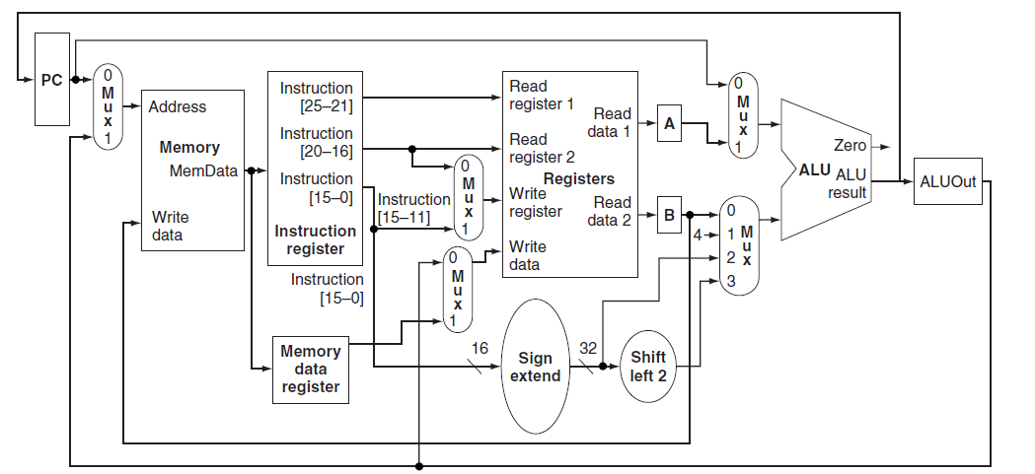
Contd.,
Replacing the three ALUs of the single-cycle datapath by a single ALU means that the single ALU must accommodate all the inputs that used to go to the three different ALUs.
Handling the additional inputs requires two changes to the datapath:
1. An additional multiplexor is added for the first ALU input. The multiplexor chooses between the A register and the PC.
2. The multiplexor on the second ALU input is changed from a two-way to a four-way multiplexor. The two additional inputs to the multiplexor are the constant 4 (used to increment the PC) and the sign-extended and shifted offset field (used in the branch address computation).

Slide 28
Contd.,
Because the datapath takes multiple clock cycles per instruction, it will require a different set of control signals.
The multicycle datapath still requires additions to support branches and jumps; after these additions, we will see how the instructions are sequenced and then generate the datapath control.
With the jump instruction and branch instruction, there are three possible sources for the value to be written into the PC:
The output of the ALU, which is the value PC + 4 during instruction fetch. This value should be stored directly into the PC.
The register ALUOut, which is where we will store the address of the branch target after it is computed.
The lower 26 bits of the Instruction register (IR) shifted left by two and concatenated with the upper 4 bits of the incremented PC, which is the source when the instruction is a jump.

Slide 29
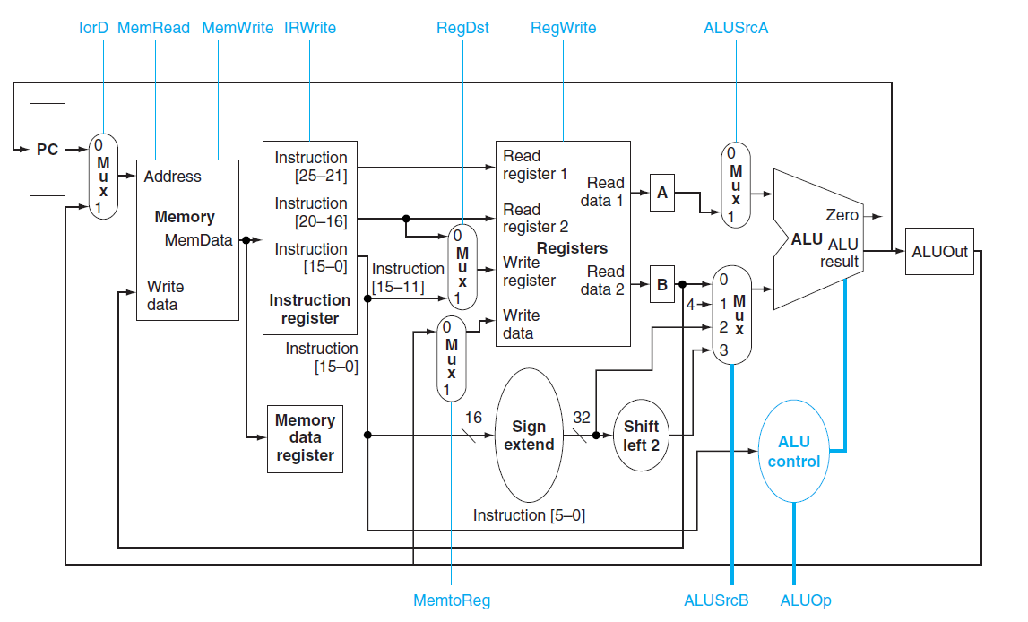
With control signals..

Slide 30
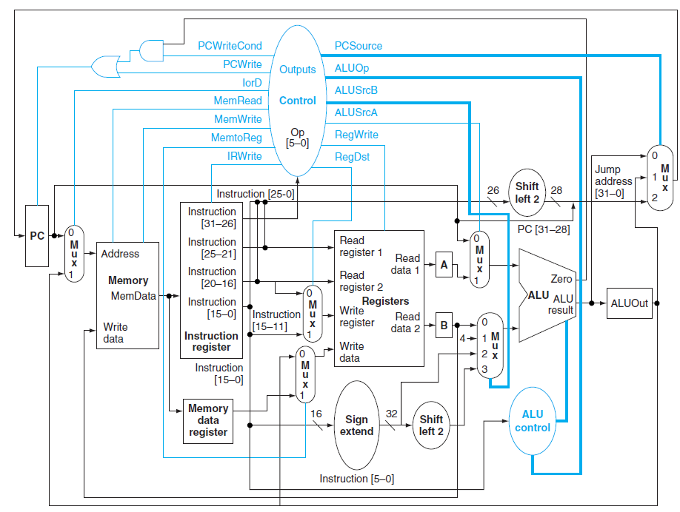
A bit more detailed..
As we observed when we implemented the single-cycle control, the PC is written both unconditionally and conditionally. During a normal increment and for jumps, the PC is written unconditionally. If the instruction is a conditional branch, the incremented PC is replaced with the value in ALUOut only if
the two designated registers are equal. Hence, our implementation uses two separate control signals: PCWrite, which causes an unconditional write of the PC, and PCWriteCond, which causes a write of the PC if the branch condition is also true.

Slide 31
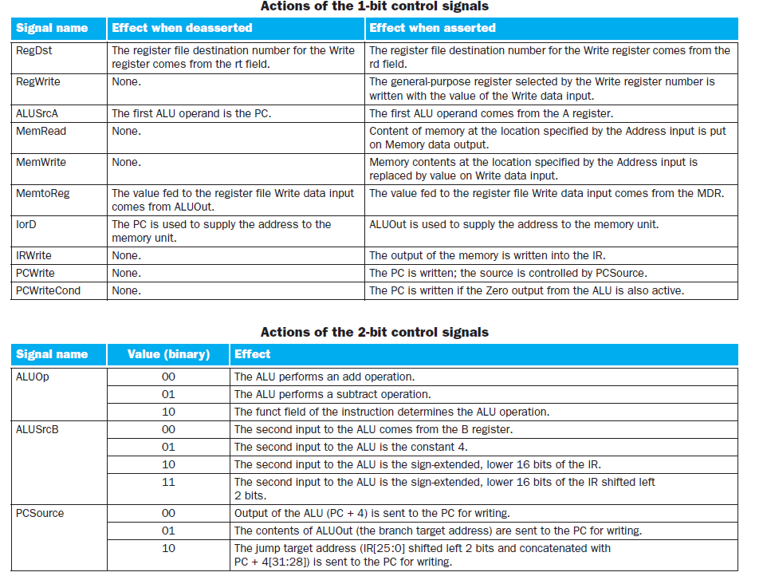
Contd.,

Slide 32
This Page is intentionally left blank.

Slide 33
@all, thanks! Lets analyze the performance. Shriram K V

